Slide 1


Presented by : Zain Asif Husnain Ali
Topic name :
Sustainable business practices

Slide 2

Why sustainability matters in a business ?
Sustainability is no longer optional—it's a strategic imperative .
Companies that prioritize environmental, social, and economic sustainability are more resilient, attract loyal customers, and often outperform competitors.

Slide 3
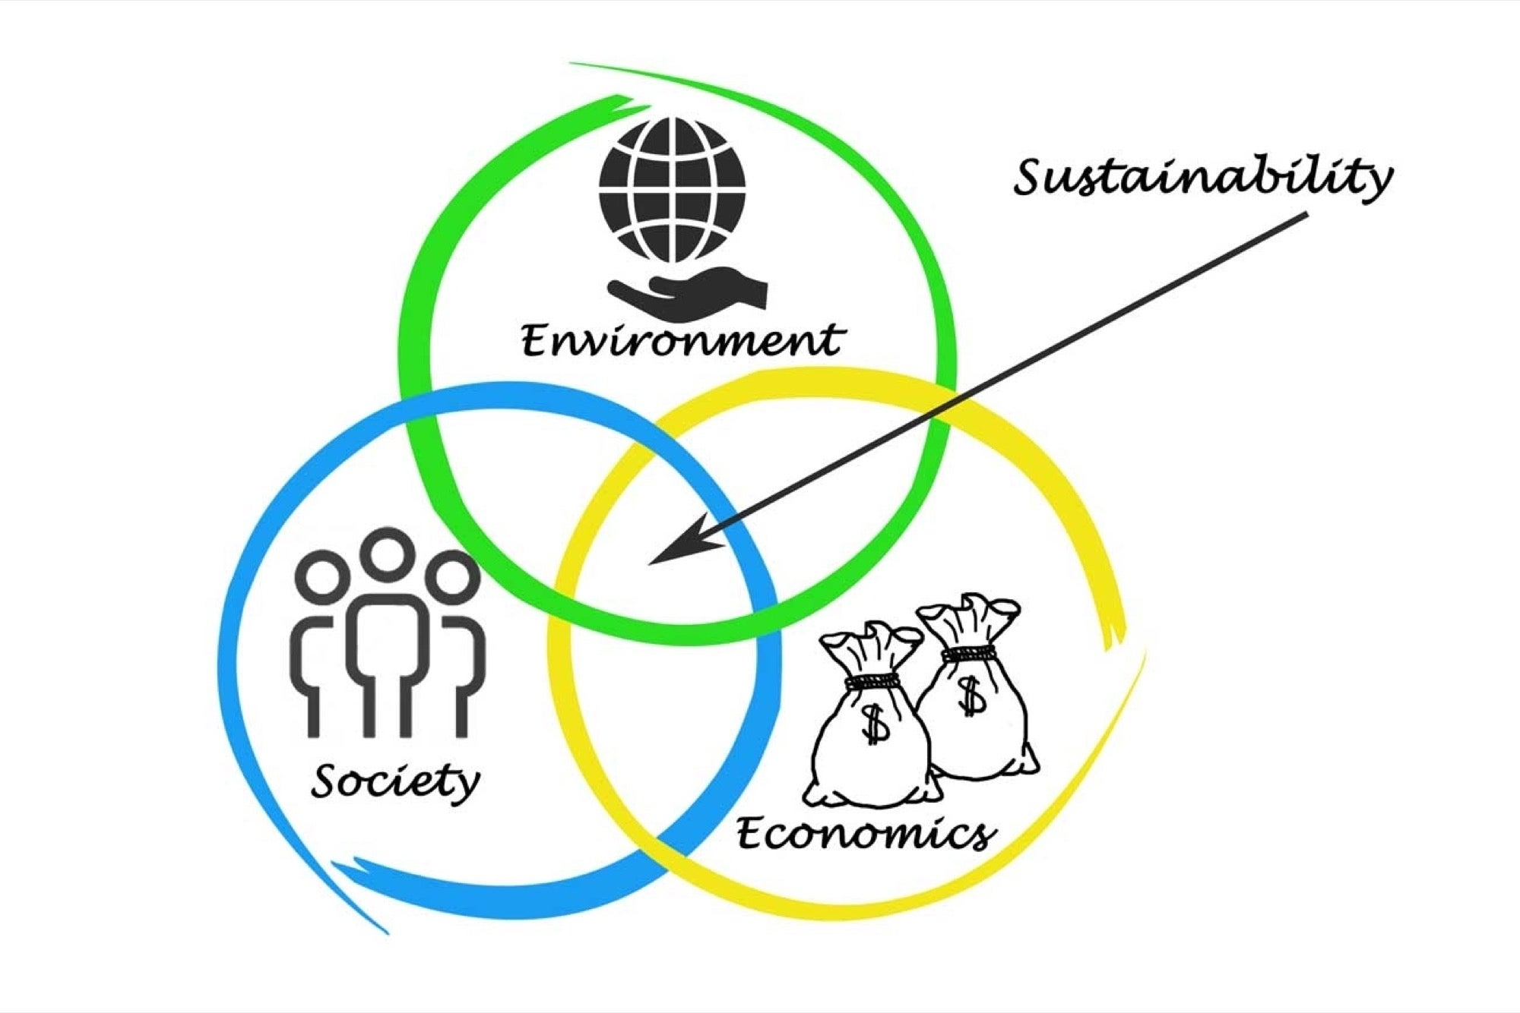
Defining Sustainability in Business ?
Minimizing environmental impact
Promoting social responsibility
Ensuring long-term economic viability
True sustainability balances people, planet, and profit—the triple bottom line. Makes a win , win situation

Slide 4
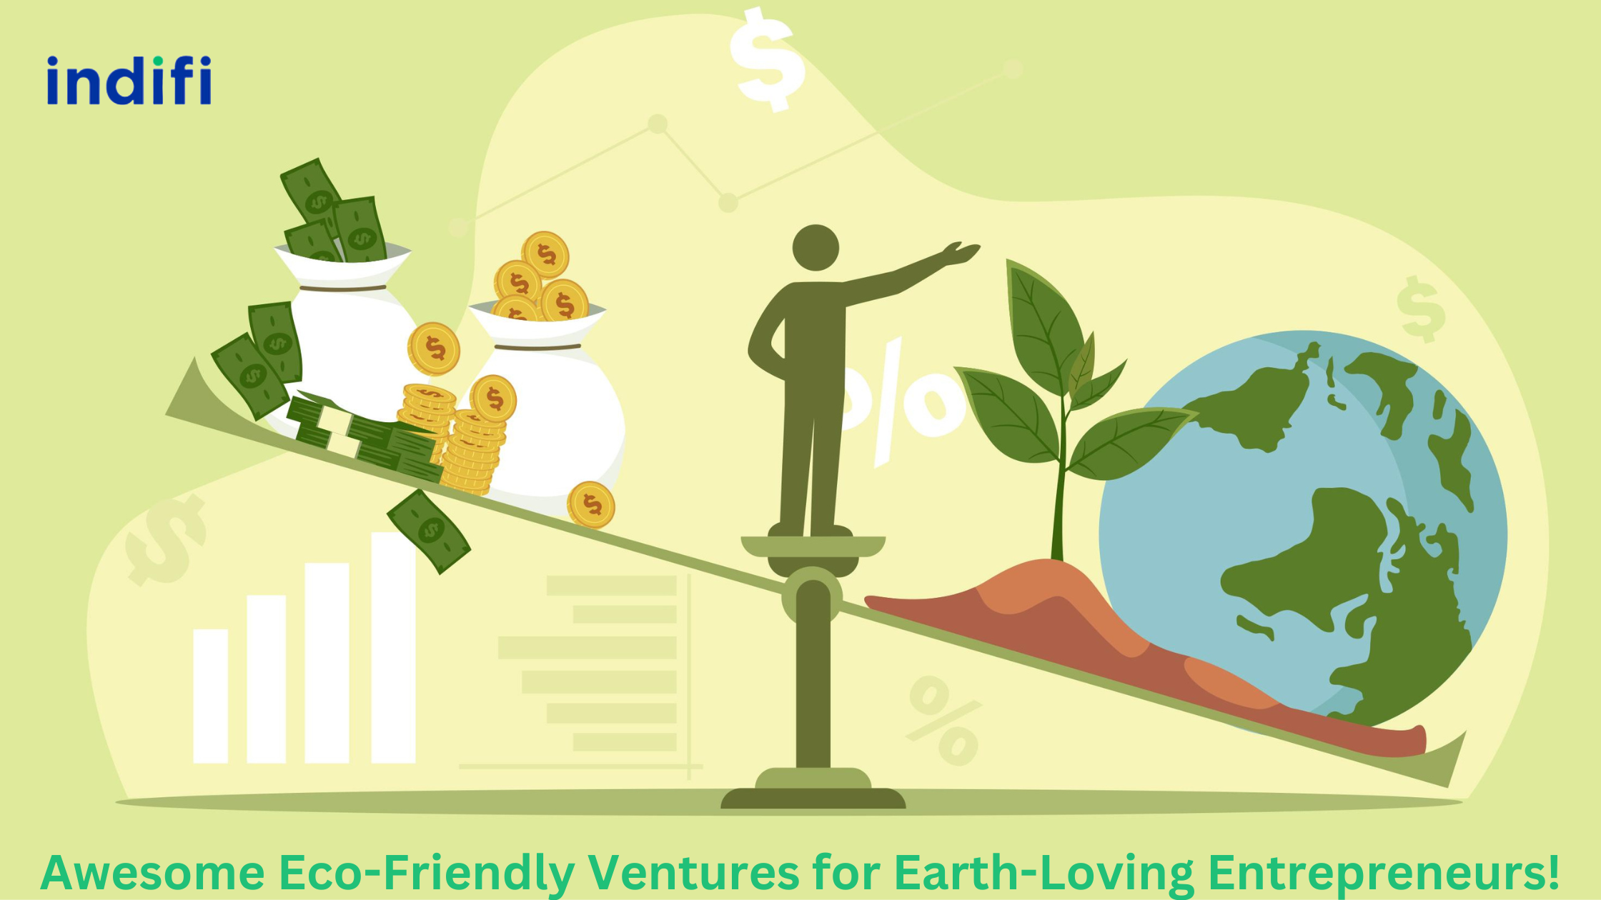
Reducing Environmental Impact
Energy efficiency
Waste reduction
Renewable energy
Sustainable sourcing
Examples: Using solar power, reducing plastic packaging, optimizing logistics to reduce emissions.

Slide 5

Social Responsibility
Fair labor practices
Diversity and inclusion
Community engagement
Ethical sourcing
Companies must respect workers' rights, support communities, and build ethical supply chains.

Slide 6

Long-Term Profitability
Sustainable growth strategies
Innovation and circular economy
Risk management and resilience
Businesses need to think long-term, using sustainable models to mitigate risks like resource scarcity or regulatory pressure.

Slide 7

Success Stories
BYD :Become world no.1 ev. selling company
IKEA: Commitment to 100% renewable energy
Unilever: Sustainable Living Plan
These companies prove that sustainability can drive success and customer loyalty.

Slide 8
Why Pakistan is too far in this field ?
Lack of Awareness and Education
Many businesses lack knowledge about sustainability and its long-term benefits .
Eco-conscious consumer demand is still developing, so businesses don’t feel strong pressure to adapt.
Cost and Financial Constraints
Eco-friendly materials and technologies often have higher upfront costs . Small and medium-sized enterprises (SMEs), which make up a large part of Pakistan’s economy, may not have the capital to invest in sustainable practices.

Slide 9

But There Is Growing Potential
Young entrepreneurs and export-oriented companies (especially in textiles and agriculture) are increasingly exploring eco-certifications and green practices to enter global markets .
Growing environmental movements and media attention are slowly shifting public and business mindsets.

Slide 10


